Slide 2

Unit 4: Managing Pages in Page Designer

Slide 3
Lesson Objectives
After completing this lesson, you should be able to:
Explain application page components
Create an application page and view its definition
Manage pages in page designer
Describe page designer UI elements
Add page components
Notes:
This lesson introduces you to page designer. First, you gain an understanding of an application page components. You learn how to create a page in an application and how to navigate to page designer. This lesson covers a detailed discussion on page designer user interface elements. You also learn how to add different page components by using the drag and drop functionality and also using context menus.

Slide 4
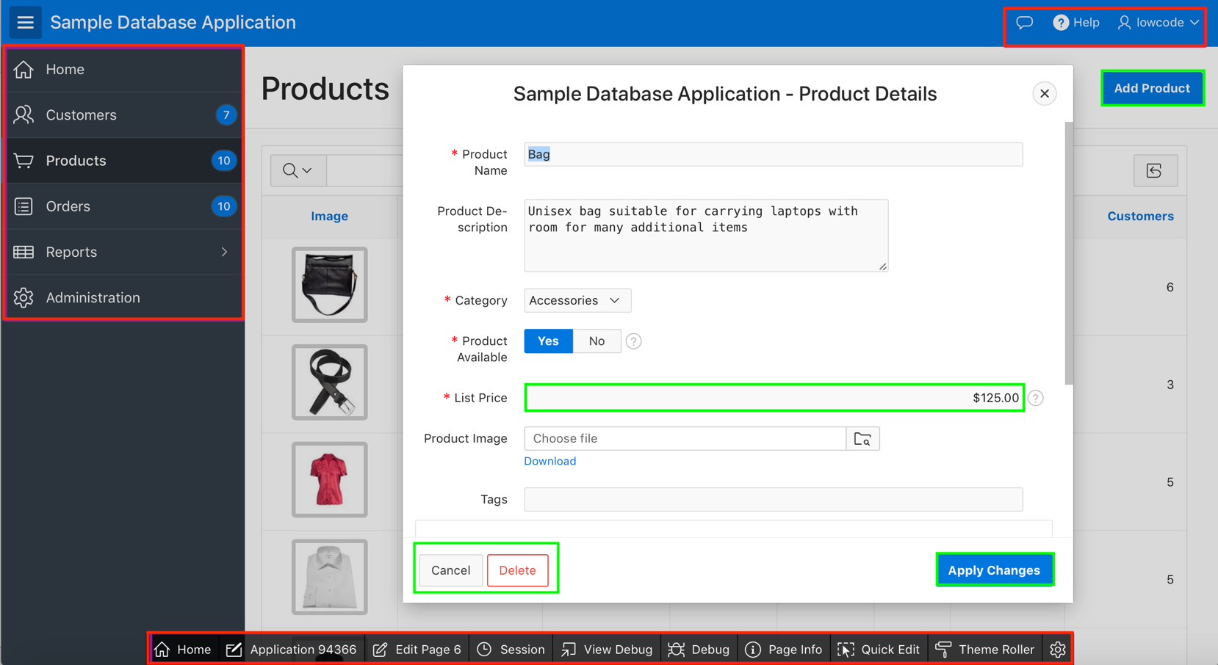
Understanding Application Page Components
Navigation Menu
Navigation Bar
Button
Region
Region
Item
Button
Button
Button
Developer Toolbar
Notes:
A page is the basic building block of an application. When you build an application in App Builder, you create pages that contain user interface elements, such as items, buttons, lists, and regions. The slide shows different components of a page.
Each page in an Oracle Application Express application contains one or more regions. Regions function as containers for content. A region can simply contain static HTML or it can be report based on a SQL query. A region can contain items, buttons and navigation menu.
An item is part of an HTML form. An item can be a text field, text area, password, select list, check box, and so on.
You use buttons to direct users to a specific page or URL, or to post or process information (for example, Create, Cancel, Next, Previous, or Delete buttons).
When you build a database application, you can include different types of navigation controls. The available navigation option depends upon the application theme. Common navigation controls include tabs, lists (including navigation menus), breadcrumbs, navigation bar entries, and branches. The slide example uses navigation menu that is displayed as a side bar.
When you run a desktop application from App Builder, the Developer Toolbar displays at the bottom of any editable running page. You use the Developer Toolbar to quickly edit the current application or currently running page, or view session state.

Slide 5
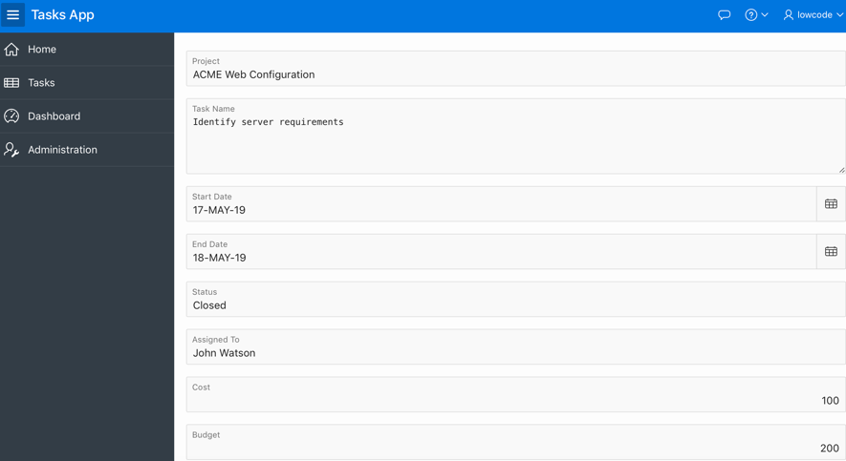
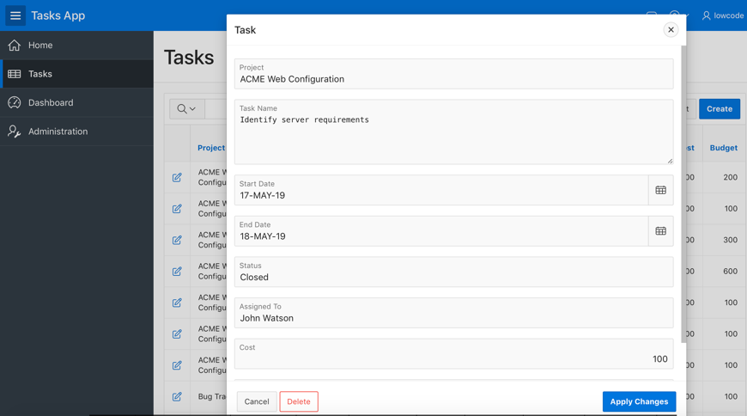
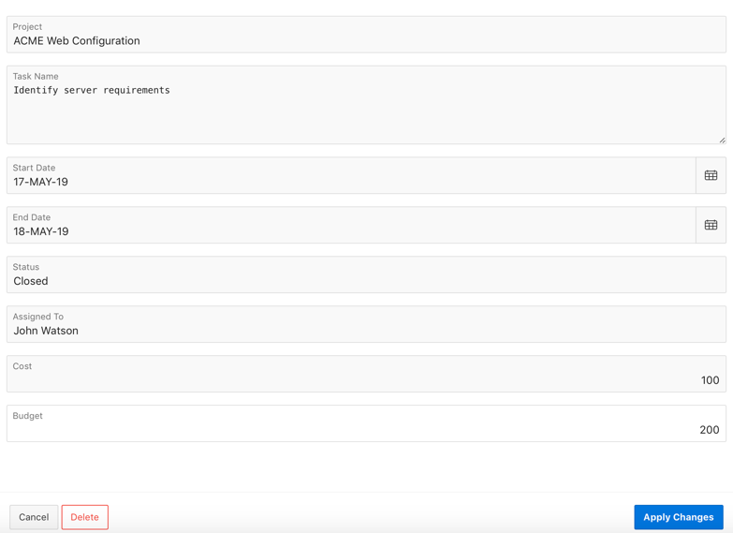
Understanding Page Modes
Normal
Modal Dialog
Non-Modal Dialog
Notes:
When you create a new page, the wizard prompts you to select a Page Mode. The Page Mode determines if the page is a normal application page or a dialog. Application Express supports two types of dialog pages: Modal and Non-Modal. Modal and non-modal dialog pages are only supported if the current application theme contains at least one page template of template type Dialog Page.
The slide shows Task page in three different page modes: Normal, Modal Dialog and Non-Modal Dialog. In the Create Page wizard, if you select Normal for Page Mode, the page is presented as a normal Application Express application page.
To create a dialog page, you need to select either Modal Dialog or Non-Modal Dialog in the Create Page wizard.
Modal Dialog: A modal dialog is an overlay window positioned within the viewport, which remains active and focused until the end user dismisses (closes) it. The underlying page is greyed out and the end user is prevented from interacting with the rest of the page until the dialog is closed.
Non-Modal Dialog: A non-modal dialog is an overlay window positioned within the viewport, where the end user can interact with the dialog, and content on the page that launched the dialog. A non-modal dialog can be used when the requested information is not essential to continue, work can continue elsewhere while the window is still open.
Note: Oracle Application Express includes dialog page templates in the Universal Theme - 42. When you set the Page Mode to either Modal or Non-Modal, Oracle Application Express automatically uses the default dialog page template.

Slide 6
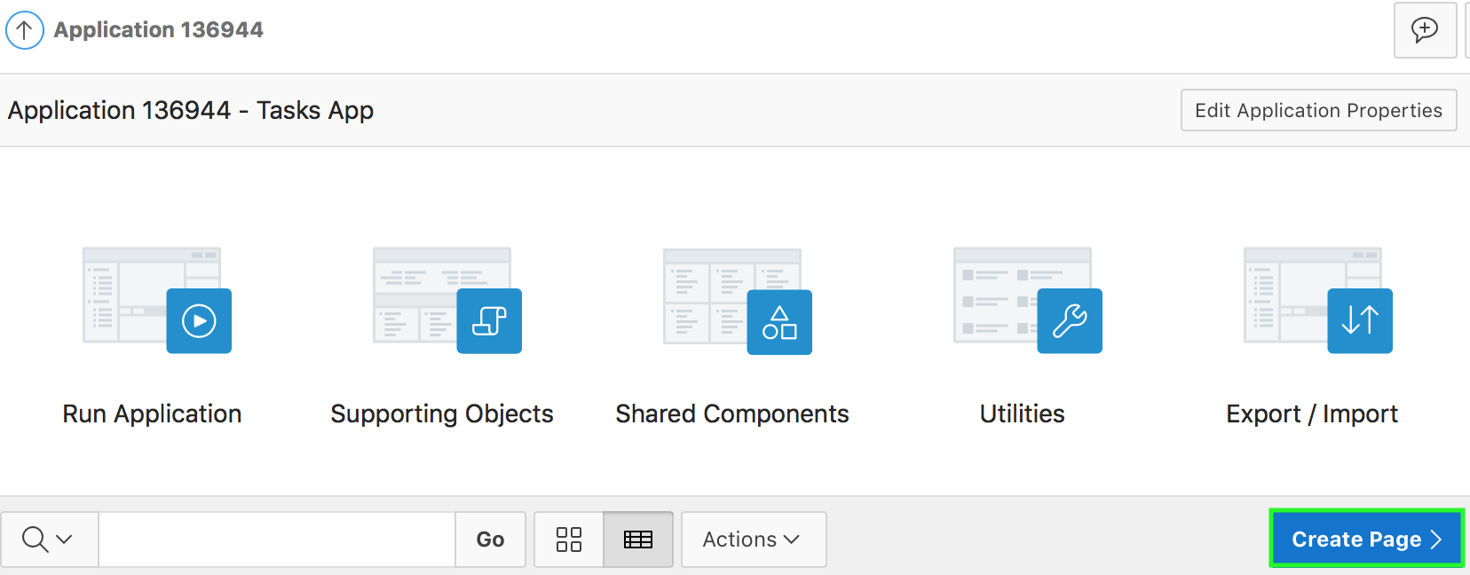
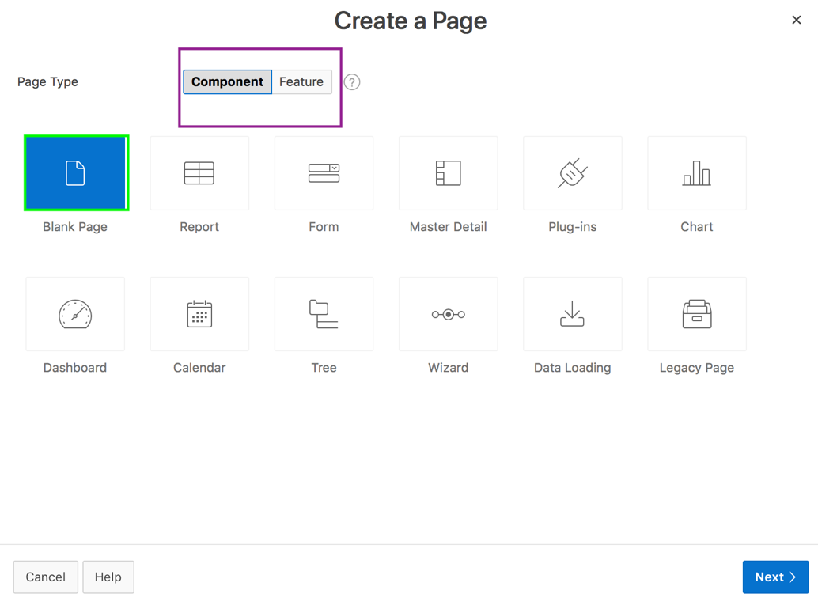
Creating a Page
2
1
Notes:
You add pages to an existing database application by running the Create Page Wizard. You can access this wizard in two ways:
On your application home page, click Create Page.
On the Page Designer Developer toolbar, click Create. Then, select Page.
The Create Page Wizard includes two types of pages:
Component pages provide page-level functionality and can be added multiple times within a given application. Examples include reports, forms, plug-ins, charts, calendar and so on.
Feature pages provide application-level functionality and are typically added once per application. Examples include About Page, Access Control, Activity Reporting, Feedback, and Login Page.
The slide example shows steps to create a page. In this example, you create a blank page. A blank page is a page with no built-in functionality. Once created, you can customize this page for your requirements. For example, you might want to create a Help page in your application. You first create a blank page, then navigate to the Page Designer and add a Help Text region on this blank page.
Steps to create a page:
On your application home page, click Create.
Select the type of page you want to create. The Page Type you select(that is, Component or Feature) determines what appears next. In the slide example, you accept the default Component.
Notice the different page types available. Select a page type that you want to create and click Next. For example, in the slide you select Blank Page for page type.

Slide 7
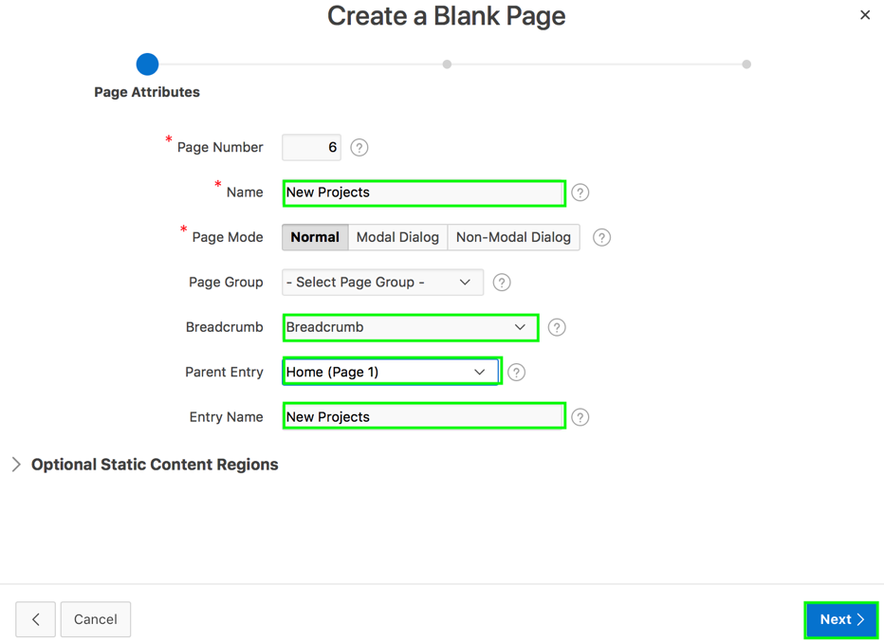
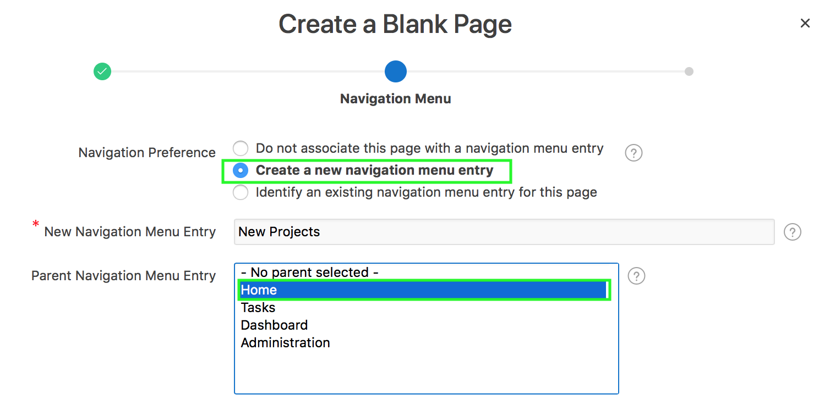
Creating a Page
3
4
Notes:
For Page Attributes, specify your choice and click Next:
Enter a name for your page. Notice that there are three different page modes available. You already learned about page modes in this lesson. In the slide example, accept the default value of Normal
Select whether you want to use a breadcrumb navigation control on your page, and which breadcrumb navigation control you want to use. The default is don’t use breadcrumbs on page. In the slide example, you select Breadcrumb, then select a value for Parent Entry and also enter a name for breadcrumb
Select how you want this page integrated into the Navigation Menu and click Next. The default is Do not associate this page with a navigation menu entry. In the slide example, you select
Create a new navigation menu entry. This will allow users to navigate to the new page directly from the Navigation Menu.
Specify a name for New Projects for New Navigation Menu Entry and
Select a parent navigation menu entry

Slide 8
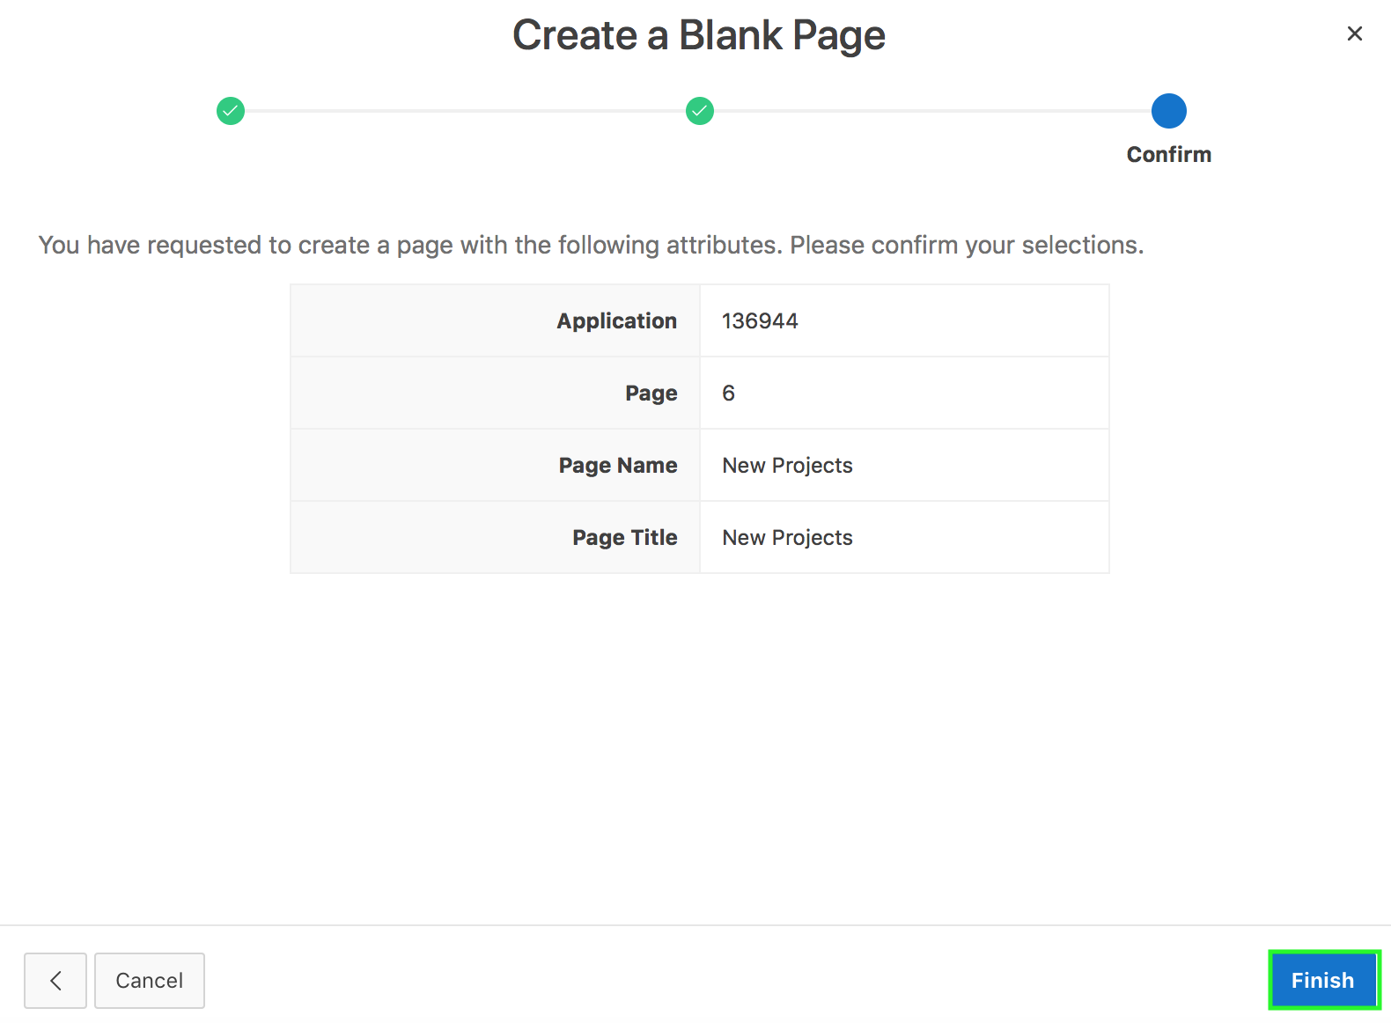
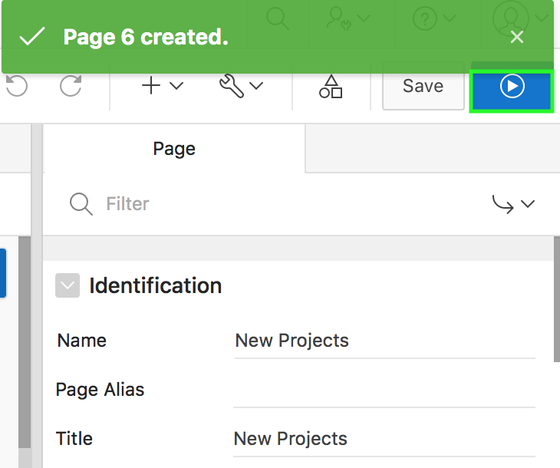
Creating a Page
6
5
Notes:
Finally, confirm your selection and click Finish.
Now you are navigated to the Page Designer. Click the Save and Run Page button.

Slide 9
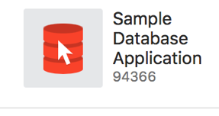
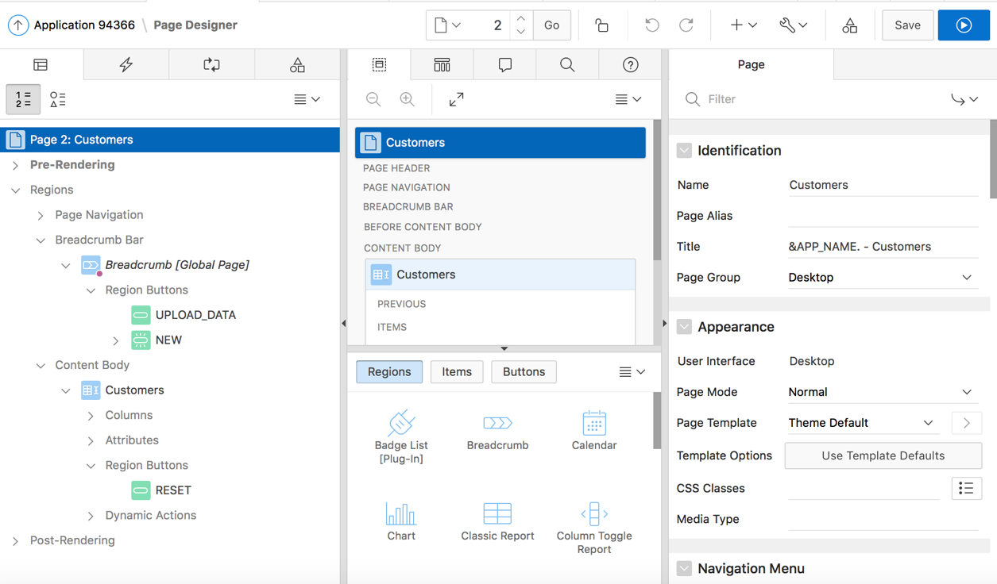
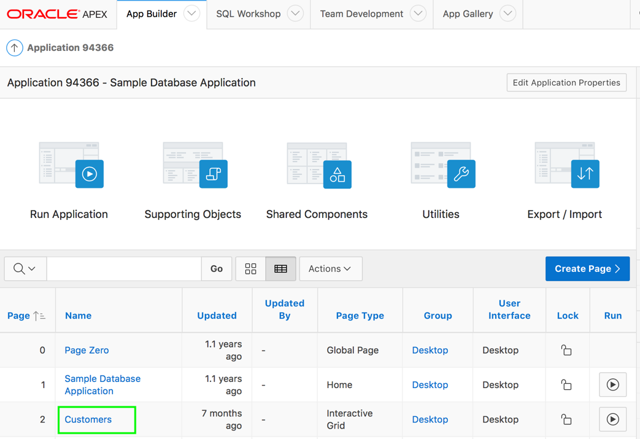
Navigating to Page Definition
3
1
2
Notes:
After creating a page, you need to navigate to the page definition to view, modify and create components on the page. For example, you might want to add a new region, or modify a button or delete an item. You use Page Designer to maintain and enhance pages within an Oracle Application Express application. Page Designer is a full featured Integrated Development Environment (IDE) that includes a toolbar and multiple panes.
To view a page definition in Page Designer, perform the following steps:
On your Workspace home page, click the App Builder icon. Then, select an application.
Select a page.
Page Designer appears. You preview a page by running it. Running an application page displays the rendered version as end users would see it.

Slide 10
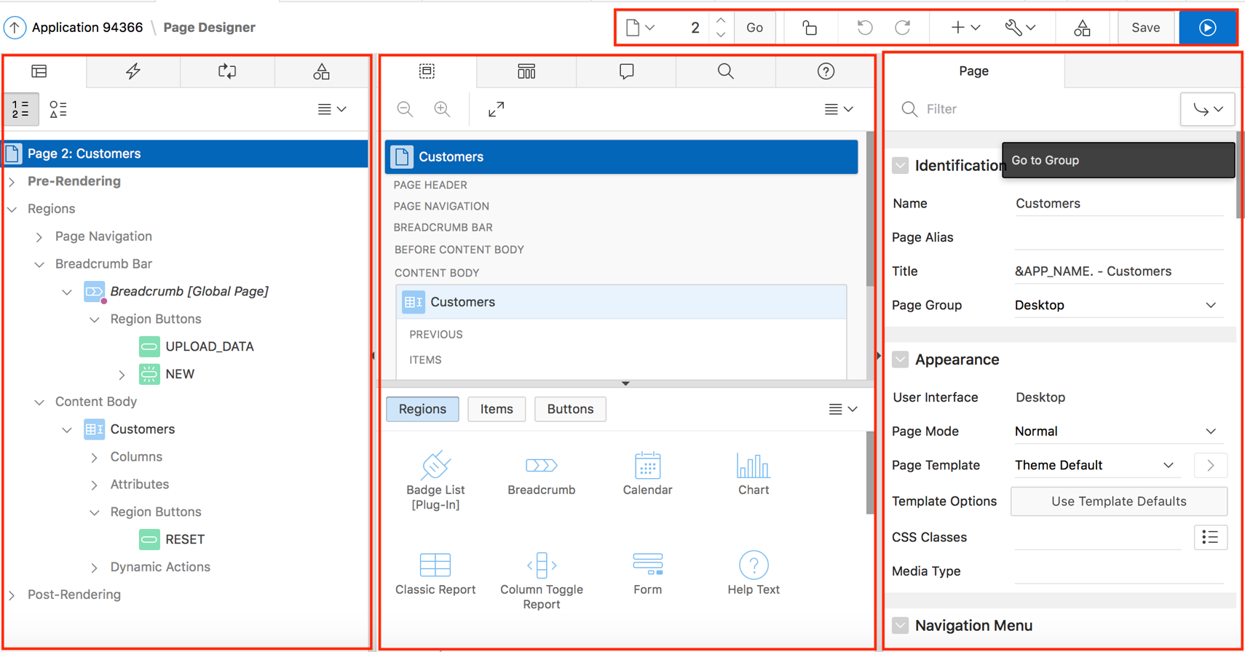
What is Page Designer?
Toolbar
Central Pane
Right Pane
Left Pane
Gallery
Notes:
Developers view and edit application pages in Page Designer. Page Designer is a full featured Integrated Development Environment (IDE) that includes a toolbar and multiple panes. There are three main panes within Page Designer: a left pane, a central pane, and a right pane. You select a component in the left or central pane and then edit the component’s attributes in the Property Editor located in the right pane.
Left Pane - Includes tabs for Rendering, Dynamic Actions, Processing, and Shared Components. Each tab displays a list of the corresponding component types and components created on the current page. Right-click to access context sensitive menus. You can also drag components up and down within the tree to change the position or sequence of the selected component.
Central Pane - Includes tabs for Layout, Component View, Messages, Page Search, and Help.
Layout shows a visual representation of the page. You add new components to a page by right-clicking to access a context sensitive menu, or dragging them the from the Gallery tab, at the bottom, and dropping them in Layout.
Component View displays user interface elements and application logic by component type. You click a component name to display the corresponding attribute in the Property Editor in the right pane.
Messages displays current errors and warnings. Clicking a message changes the focus within Property Editor to the corresponding attribute associated with the error or warning.
Page Search enables you to search all page metadata including regions, items buttons, dynamic actions, columns, and so on.
Help displays attribute specific help. Click on the attribute name within Property Editor to view information and examples for that attribute.
Right Pane - Displays the Property Editor. Use the Property Editor to update attributes for the selected component(s). When you select multiple components the Property Editor only displays common attributes. Updating a common attribute will update that attribute for all of the selected components.
You can adjust the size of each pane by selecting and dragging the horizontal and vertical splitters. To expand or collapse each pane, click the small triangle labeled Collapse in the center of each splitter.

Slide 11
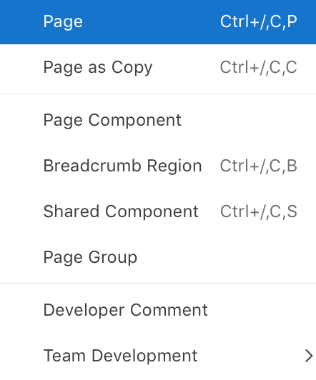
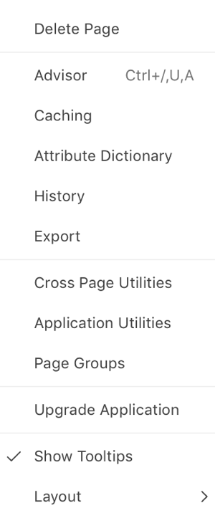
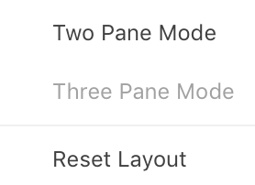
Understanding Page Designer UI Elements: Toolbar
Redo Changes
Page Selector
Create
Page Lock
Utilities
Undo Changes
Save and Run Page
Shared Components
Notes:
The Page Designer toolbar displays at the top of the page and contains both buttons and menu options. Passing your cursor over an active button and menu, displays a Tooltip.
Page Selector: Displays the current page. Click the down arrow to display the Page Finder and search for pages, or enter a page number in the field and click Go.
Page Unlocked and Page Locked: Indicates whether a page is locked or unlocked. Unlocked pages are editable and locked pages are not. The padlock icon indicates
the status:
Clear unlocked padlock — Page is unlocked.
Green locked padlock — Page is locked by you.
Red locked padlock — Page is locked by another user. To view the lock owner, or update the lock comment, click the red padlock.
Undo Change: Reverts the previous update you made within Page Designer. Applies to actions that result in a change to the page data.
Redo Change: Reapply the last update that was undone using Undo Changes. Applies to actions that result in a change to the page data.
Create: The Create menu features a graphical plus sign (+). Clicking the Create menu displays the following options:
Page
Page as Copy
Page Component
Breadcrumb Region
Shared Component
Page Group
Developer Comment
Team Development
Utilities: The Utilities menu features a graphic of a wrench. Options include:
Delete Page
Advisor
Caching
Attribute Dictionary
History
Export
Cross Page Utilities
Application Utilities
Page Groups
Upgrade Application
Show Tooltips
Layout
Shared Components: Links to the Shared Components page. Shared components can display or be applied on any page within an application.
Save: Saves the current page.
Save and Run Page: Saves and then runs the current page

Slide 12
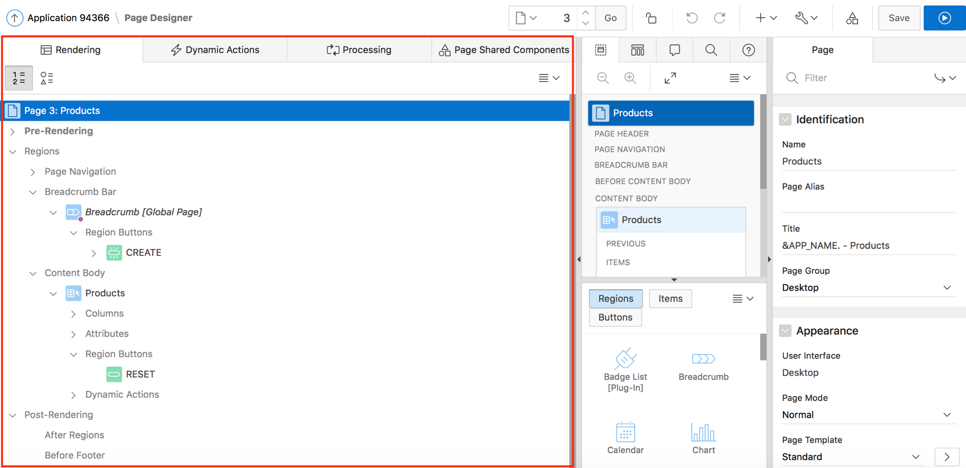
Understanding Page Designer UI Elements: Left Pane
Notes:
The left pane in Page Designer includes four tabs: Rendering, Dynamic Actions, Processing, and Page Shared Components. Each tab displays a list of the corresponding component types and components created on the current page.
The Rendering tab displays regions, page items, page button, page components, and application logic.
The Dynamic Actions tab displays dynamic actions defined on this page. By creating a dynamic action, you can define complex client-side behavior declaratively without the need for JavaScript. You learn about dynamic actions later in this workshop.
The Processing tab displays application logic defined on this page.
The Page Shared Components tab displays shared components associated with this page.
Key features of the Left pane include:
Context menus: Right-click a component or control to display a context menu.
Quick Access to the Property Editor: Select a component or multiple components to display the corresponding attributes in the Property Editor in the right pane.
Drag and Drop: Drag components up and down within the tree to change the position or sequence of the selected component.
Tooltips: Position the mouse over a component or control to view a tooltip of basic information, such as the region type, item type, and so on.
The Rendering and Processing trees are grouped and ordered based on how Oracle Application Express processes them. The Dynamic Actions and Page Shared Components trees are grouped by event or component type and then ordered by sequence. If you want to manage the display of the components in the tree, click Group by Processing Order or Group by Component Type buttons.

Slide 13
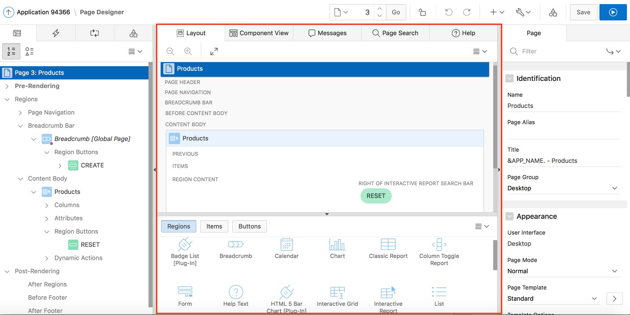
Understanding Page Designer UI Elements: Central Pane
Gallery
Notes:
The central pane in Page Designer contains five tabs:
Layout: Displays a visual representation of the page regions, items, and buttons that define a page
Component View: Displays user interface elements and application logic by component type.
Messages: Displays errors and warnings you need to address. Clicking a message changes the focus within Property Editor to the corresponding attribute associated with the error or warning
Page Search: Allows you to search all page metadata including regions, items buttons, dynamic actions, columns, and so on.
Help: Displays attribute specific help. Click on the attribute name within Property Editor to view information and examples
Gallery: The Gallery pane displays at the bottom of the Layout tab and contains three tabs: Regions, Items, and Buttons. You can add new controls and components (regions, items, and buttons) to a page by selecting them in the Gallery and dragging and dropping them into the Layout tab.

Slide 14
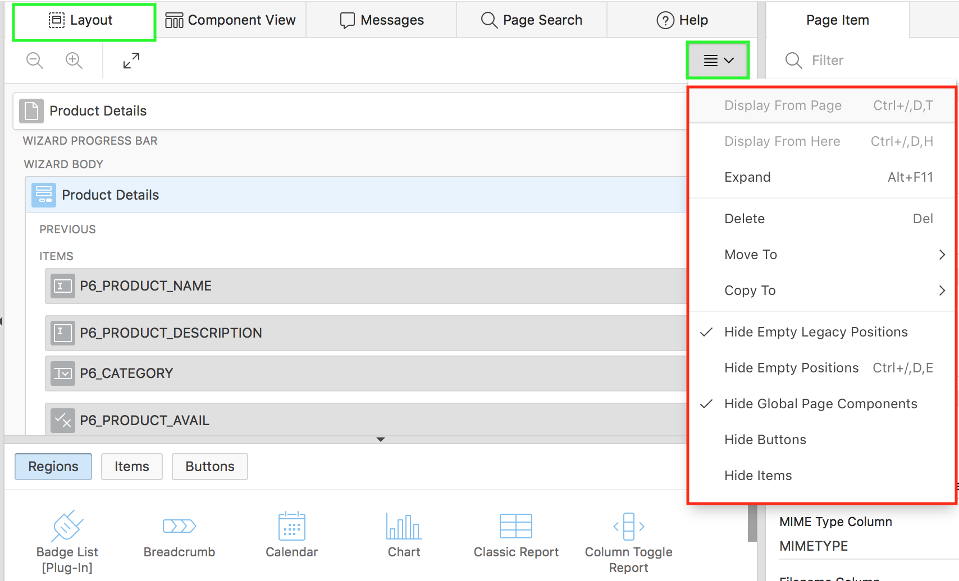
Page Designer UI Elements: Central Pane - Layout
Notes:
The Layout tab displays in the central pane of Page Designer and is a visual representation of how the components are positioned on the page. The Layout tab features context menus. By selecting a component and right-clicking, you can delete, move, or copy the component to other regions, or new regions on the page. A region is an area of a page that serves as a container for content.
You can also move existing regions, items, and buttons relative to other components by simply clicking on the component and dragging it to the new location. For example, you can place items next to one another by dragging the second item to the end of the first item and dropping it in the dark yellow box that appears when you hover in the desired location. When dragging components to a new position, such as dragging an item onto the same line as an exiting item, you need to drag the component into the desired position and wait until the grid changes and the new drop position displays.
You can quickly add new components to an existing page by dragging the component from the Gallery up to the desired position within the Layout tab. You can adjust the size of each pane by selecting and dragging the horizontal and vertical splitters. To expand or collapse each pane, click the small triangle labeled Collapse in the center of each splitter. Alternatively, you can click the Expand button to make the Layout tab larger and then Restore to return it to the previous size.
The Layout menu displays on the right side of the pane. You can use this menu to customize the type and amount of information that displays and to delete, move, and copy selected components. To have a specific region fill the Layout tab, select the region and select Display from Here from the Layout menu. The selected region fills the Layout tab. To restore the view, select Display from Page.
Note: Hidden items are not displayed in Layout, but are displayed in the Rendering tree.

Slide 15
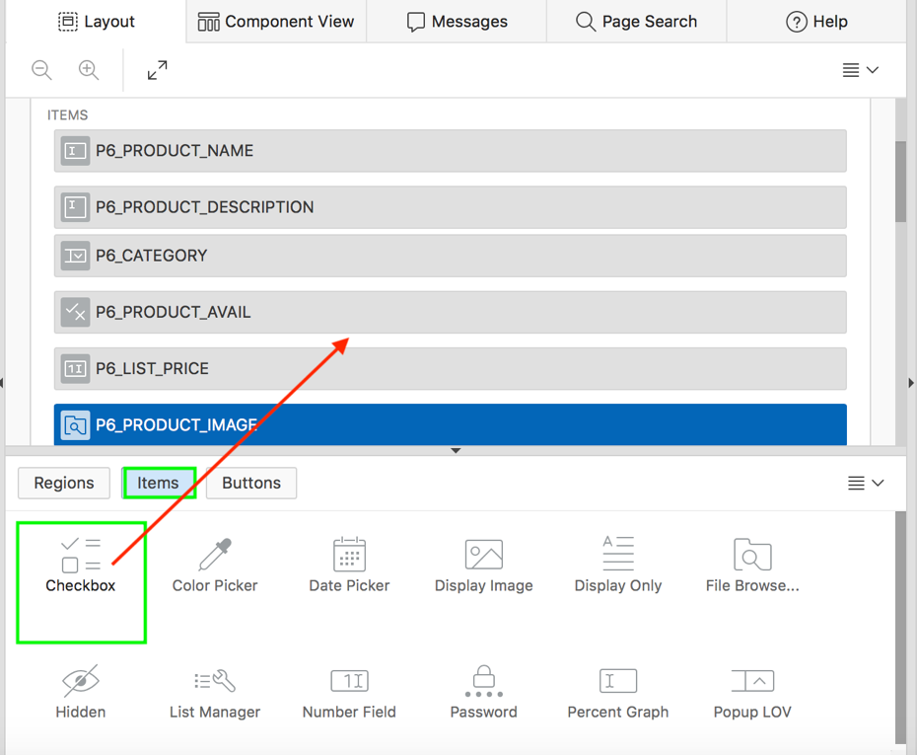
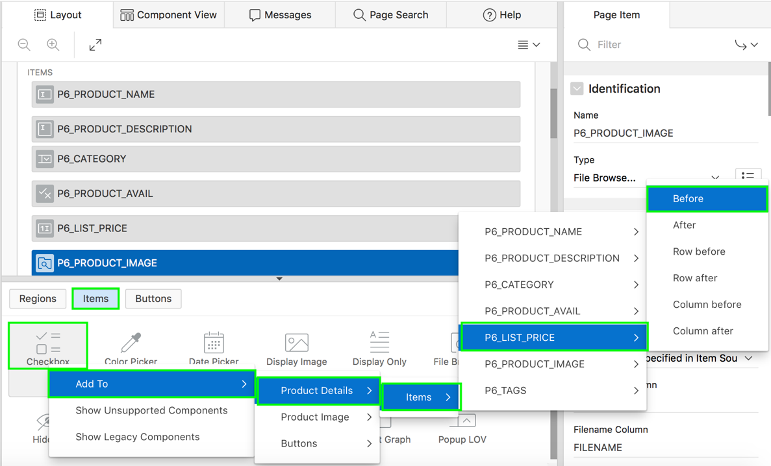
Adding Components from the Gallery
Drag and drop from the Gallery
Using the Context Menu
Notes:
The Gallery displays at the bottom of the central pane of Page Designer and contains three tabs: Regions, Items, and Buttons. When you pass the cursor over a control or component, a tooltip displays that describes it. You can adjust the size of the pane by dragging the horizontal and vertical splitters. To collapse or restore the Gallery pane, click the small triangle in the center of each splitter.
You can add new controls and components to a page by using either of the following two ways:
Selecting a control or component and dragging and dropping them into the Layout tab
Selecting a control or component in the Gallery and right-click to use a context menu.
Each application page can have buttons and fields (called items) which are grouped into containers called regions. You can add regions, items, and buttons to a page by dragging and dropping them from the gallery.
The slide example shows adding a checkbox item before P6_LIST_PRICE. To achieve this, navigate to gallery. Select Checkbox, drag it and drop it in P6_LIST_PRICE item. A new checkbox item is now added before P6_LIST_PRICE. The slide example also shows using the context menu to add the Checkbox item. In the slide, right-click Checkbox, select Add To from the Context menu and choose the item location as Product Details > Items > P6_LIST_PRICE_BEFORE.
You learn more about items later in this course.

Slide 16
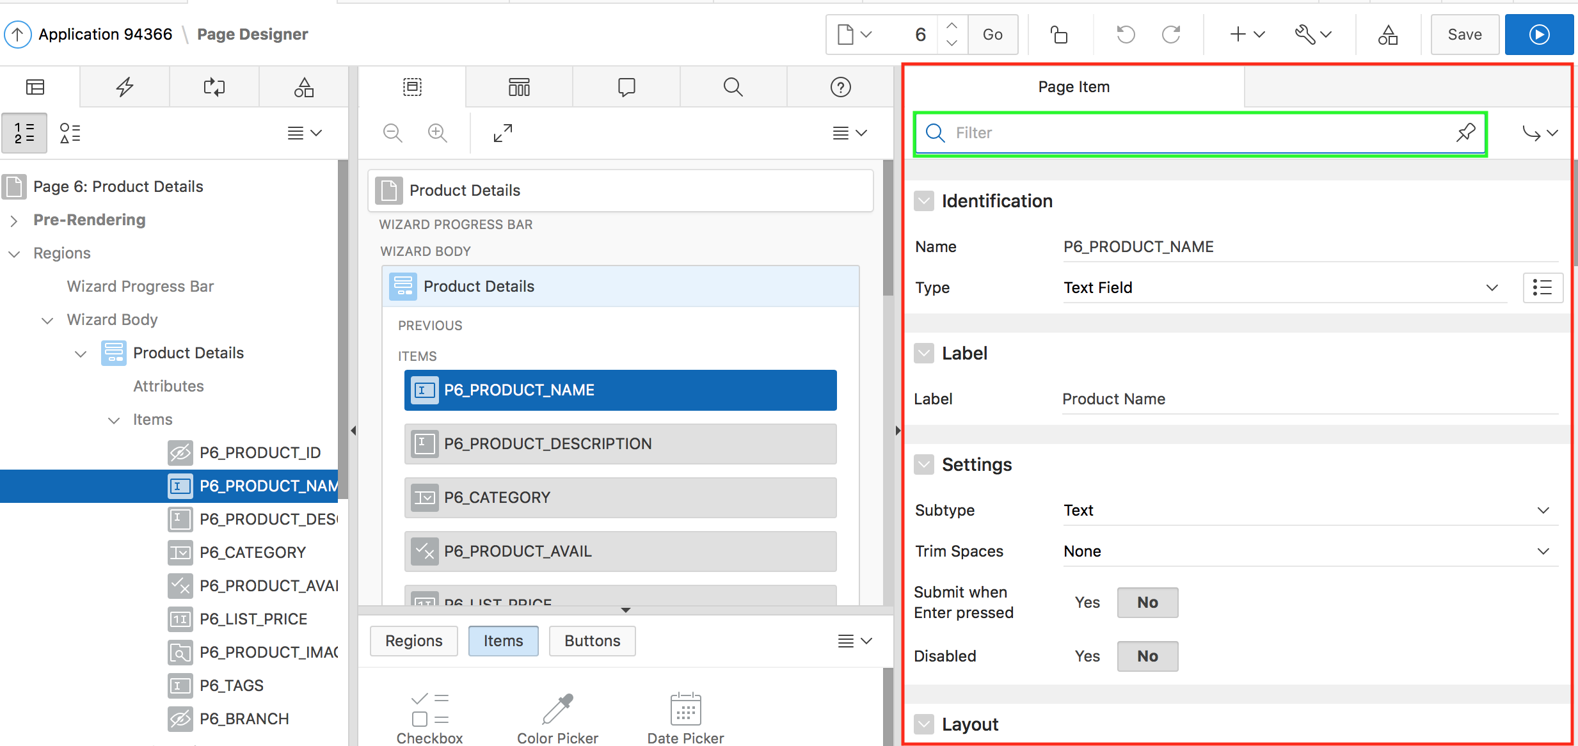
Understanding Page Designer UI Elements: Property Editor
Notes:
The right pane in Page Designer contains the Property Editor. Property Editor displays all attributes for the current component. As you select different components in either the left pane or the Layout tab, the Property Editor automatically updates to display attributes for selected component. When you select multiple components, the Property Editor only displays common attributes. Updating a common attribute updates that attribute for all of the selected components.
Property Editor organizes attributes into functional groups. To quickly access a group, click Go to Group and select the group. To return the default display, click Go to Group again and select Expand All.
To search for a group or an attribute, enter a keyword in the Filter Properties field. The groups and attributes containing the keyword appear. To return to the default display, delete the keyword in the Filter Properties field. To search for keywords across all items, regions, and processes, click the Pin Filter button on the right side of the search field. When activated, you can search terms you enter remain persistent as you click around Page Designer. Click Pin Filter again to disable
Click the Pin Filter button on the right side of the search field to search across all items, regions, and processes. You can “pin” keywords to have them persist as you click around Page Designer. To “unpin” the search, click the Pin Filterbutton again.

Slide 17
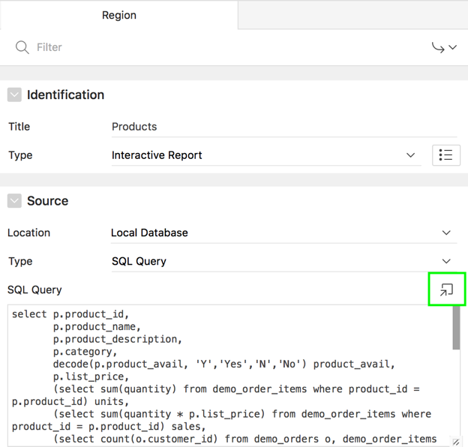
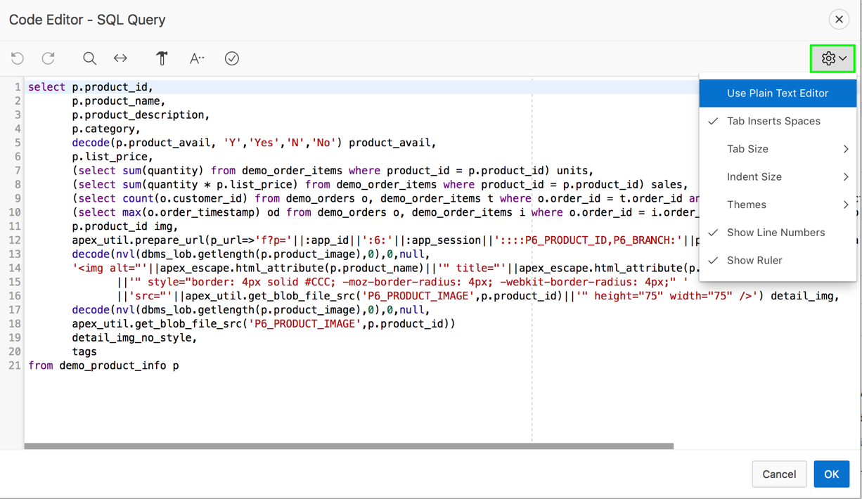
Using the Code Editor
Notes:
For attributes requiring large amounts of code (for example, a Region Source), you can:
Enter text directly in to the field.
Click Code Editor to enter text a full featured code editor.
A Code Editor displays as a modal dialog. You use the Code Editor to edit attributes requiring a large amount of code. The Code Editor provides an enhanced code editor to edit PL/SQL, SQL, HTML, CSS, and JavaScript component properties. The code highlighting is determined by the input required for the specific property.
Key features of the Code Editor include:
Undo - Ctrl+Z
Redo - Ctrl+Shift+Z
Find - Ctrl+F
Replace - Ctrl+Shift+F
Query Builder
Auto Complete - Ctrl+Space
Validate
Syntax highlighting
Block indent and unindent
Resize dialog
To switch to a plain text editor, select Use Plain Text Editor from the Settings menu. The Settings menu located on the right side offers additional options including: Use Plain Text Editor, Tab Insert Spaces, Tab Size, Indent Size, Themes, Show Line Numbers, and Show Ruler.

Slide 18
Summary
In this lesson, you learned how to:
Create a page in your application
View the page definition
Use page designer UI elements
Manage pages in page designer
Notes:
In this lesson, you learned how to manage your application pages using page designer.

Slide 19


Slide 20
Hands-on Lab

